Slide 1
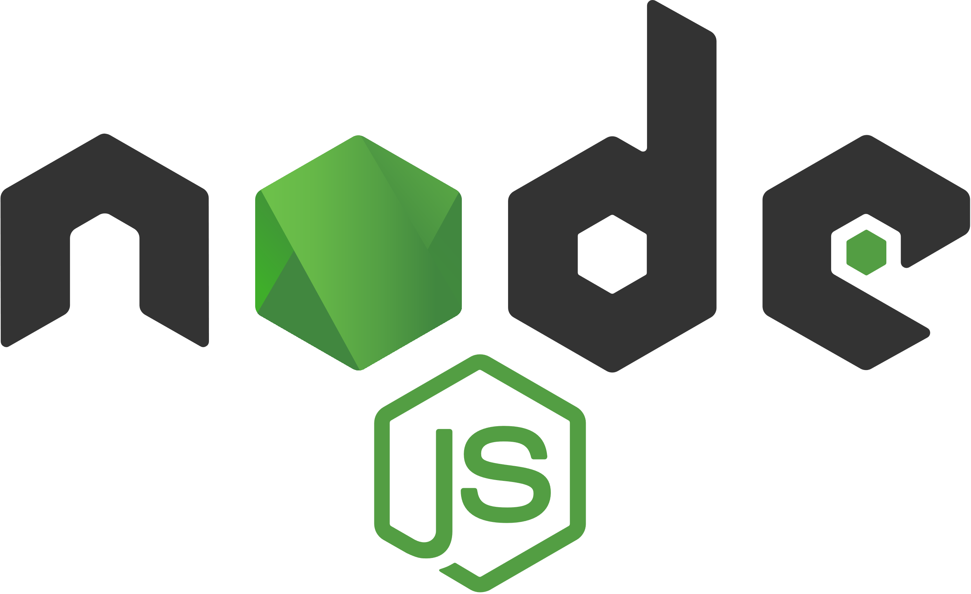
CPNT-262 Node.js

Slide 2
Forms

Slide 3
Sending Data
So far, we’ve been requesting data from the server, but we can also send data to the server.
HTTP Request Methods
GET – app.get – deals with requests that use the GET HTTP method
POST – used to send data to the server
Let’s post some data!

Slide 4
Activity: Create a form
In a new create-post.html file, add the following form code:
Add at least one other form field. Maybe the blog post title?
The action attribute is the endpoint that the form data will be sent to.
<form action="/create-post" method="POST">
<textarea name="blogpost" rows="5" placeholder="Write a new blog post!"></textarea>
<button type="submit">Publish</button>
</form>

Slide 5
Streams
Data comes to the server in streams.
With a pure Node server, we’d have to write code to collect the stream of data properly. But Express handles that for us.
To make this work for us, we need to define a route to deal with requests that come through on the /create-post endpoint.

Slide 6
Post Data
To post data, we’ll use app.post() instead of app.get()
app.post("/endpoint", (req, res) => {
});

Slide 7
Activity: Post data
Use app.post with the “/create-post” endpoint to send form data to the server
Inside your app.post function, console.log request.body. You should see undefined. We’ll have to do something else in order to access the form data.
Notes:
With the code above, you can visit localhost:8000, localhost:8000/about.html, and localhost:8000/contact.html

Slide 8
express.urlencoded()
When data is posted to the server as FormData, we can’t extract it from the req.body like we normally could.
Let’s use some Express middleware (express.urlencoded()) to help us out with this.
recognizes the incoming request object as strings or arrays
extended: true is the default and allows you to parse more types of Request Object
app.use(express.urlencoded({ extended: true }));

Slide 9
Activity: Parse Incoming Requests
Use express.urlencoded() between your app.use statement and your app.post statement. (in the middle!)
(Add it above all of your routes as you’ll need it for other app.post statements later).
Now log req.body to the console inside your app.post statement.
What do you see in the terminal now?

Slide 10
Activity: End the Request
We need to end the response to the client.
We can use res.end() OR we can redirect to another page (which also calls res.end() for us).
Create a thank-you page and redirect to it at the end of your app.post statement or you can redirect back to the same /create-post page.
res.redirect("/thank-you");

Slide 11
Template Engines

Slide 12
What is a template engine?
Template engines allow us to add data to a view and generate HTML dynamically.
Express uses Pug by default, but there are a ton of choices:
Pug
Handlebars
Mustache
EJS
Notes:
So how do we do this?

Slide 13
Pug
For this course, we’re going to use Pug (but feel free to check out alternatives).
First, you must install pug as a dependency
Then, we need to tell Express where to look for the .pug files and that we’re using Pug as our engine of choice. We can place this at the top of our file under our import statements.
const path = require("path"); // require path - utilities for working with file and directory paths
app.set("views", path.join(__dirname, "views"));
app.set("view engine", "pug");
Notes:
At the top of our index.js file, we should require path along with the other modules.
Under const app, we should then set the views folder and the view engine. This tells Express where to find the views folder and also that we’ll be using pug files.

Slide 14
From Static to Dynamic
Now that we’re using dynamic templates instead of static templates, we need to update our index.js file to reflect this change.
Instead of using:
We need to create separate routes for each page.
app.use(express.static("views"));

Slide 15
Activity: Create Routes
For each page you’ve created, write an app.get statement to render the appropriate file.
// create routes
app.get("/", (req, res) => {
res.render("index");
});

Slide 16
From Static to Dynamic
If we try to refresh the app in the browser now, we’ll get an error:
Failed to lookup view "index" in views directory
That’s because our app is looking for pug files now.
So let’s create them!

Slide 17
Learning Pug Syntax
Converting HTML to Pug is all well and good, but let’s actually learn how to use the right Pug syntax
doctype html
head
meta(charset='UTF-8')
meta(name='viewport' content='width=device-width, initial-scale=1.0')
meta(http-equiv='X-UA-Compatible' content='ie=edge')
title Document
h1 Welcome
Notes:
Pug takes the tag name as the first thing in the line, and the rest of the content goes inside that line.
You get rid of all the angle brackets <> and the code looks much cleaner.
Indentation is incredibly important. To show that tags are nested in other tags, you must indent.

Slide 18
Learning Pug Syntax
Set the doctype
Id and class attributes
doctype html
h1#title Welcome
h2.subtitle All About Pug Syntax

Slide 19
Learning Pug Syntax
Nested elements
Attributes
nav
ul
li
a(href='/about') About
li
a(href='/create-post') Create Post
a.nav-link(href='/create-post' title="Create Post") Create Post

Slide 20
Learning Pug Syntax
There’s a lot more to Pug syntax (though what we’ve covered will get you started).
For more information: https://flaviocopes.com/pug/

Slide 21
Activity: Convert to Pug
Save your .html files as .pug files.
Convert your HTML into Pug syntax.
Now, you should be able to load your app like before, except now you’re using Pug instead of HTML!
Note: You can also use this handy html to pug converter to change your HTML into a Pug template file. (https://html-to-pug.com/). Before you use this, try to convert at least one .html file on your own!

Slide 22
Pug – 404
You can change your 404 middleware to render a specific 404 page.

Slide 23
Activity: Add 404 Page
Create a 404 page using pug.
Rewrite your 404 middleware in index.js to render the 404 page instead of sending a message.
Check to make sure your code works.

Slide 24
Interpolating Variables
Passing in data to our templates.

Slide 25
Interpolating Variables
Sometimes you want to pass data into the templates
index.js
index.pug
app.get("/", (req, res) => {
res.render("index", { greeting: "Hello there!" });
});
h1 #{greeting}
Notes:
Demo what this looks like on the homepage when you refresh in the browser.

Slide 26
Iterating over variables
index.js
index.pug
app.get("/", (req, res) => {
res.render("index", { greetings: ["Hello", "Bonjour", "Hola", "Ciao"] });
});
each greeting in greetings
h1= greeting
Notes:
Demo what this looks like on the homepage when you refresh in the browser.

Slide 27
Layouts

Slide 28
Layouts
You can create layouts that all of your pug files can use.
To do this, create a template or layout.pug file.
Use the block keyword to specify default content that can be overwritten in other .pug files.
main#main
block content
Notes:
Demo what this looks like on the homepage when you refresh in the browser.

Slide 29
Layouts
In the other .pug files, you can specify that you’re extending the particular layout.pug file.
Use the block keyword followed by a unique name to specify what block you’re creating or overwriting.
extends layout.pug
block content
h1 This headline will overwrite any default content in the content block.

Slide 30
Activity: Use Layouts
Refactor your .pug files to use 1 main layout.pug file.
This file should include:
doctype html
head
block title with default information
body
header
block content with default information
footer

Slide 31
Activity: Use Layouts
Edit the rest of your .pug files to extend this layout.pug file.
Use block title and block content to overwrite the page titles and main content.
When testing, you should see the same header and footer across all pages, but the rest of the content should change.

